Slide 1
Transit Phone Application
User Personas
Defining Personas to understand their behaviors, frustrations, and goals
Product Improvement Case Study
Praneeth Koduru

Slide 2
Why Define Personas?
Personas help us understand real users’ goals, behaviors, and pain points, so we can design features that solve actual problems instead of making assumptions.
They guide product decisions by keeping the user at the center, helping prioritize features and UX improvements that align with user needs.

Slide 3
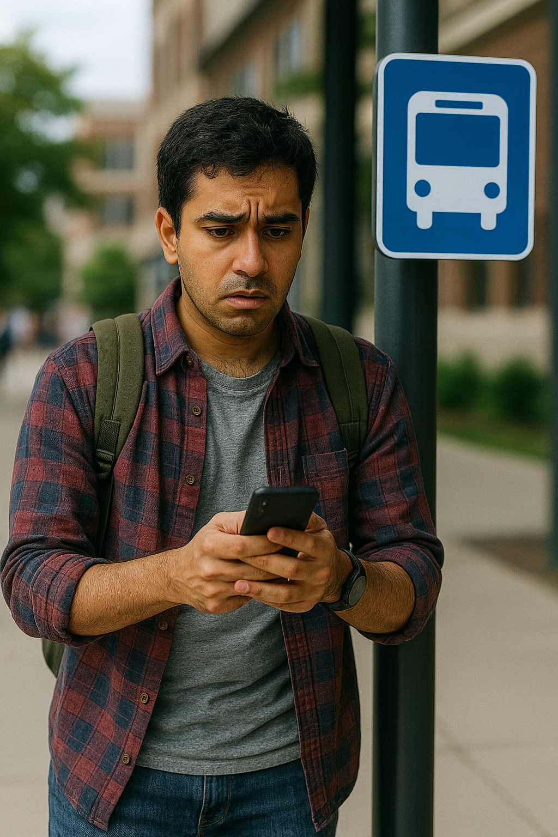

Personas
We created two persons based on Survey.
Ramesh – The Daily Commuter
Priya – The Occasional User

Slide 4
Ramesh
Attribute | Description
Name | Ramesh Kumar
Age | 27
Occupation | Graduate Student / Part-time Worker
Goals | Catch buses on time, plan commutes efficiently, avoid long wait times
Frustrations | - No proper live tracking - Incorrect wait times - Arrival estimates are unreliable
App Usage | Every Day
Needs | - Real-time bus tracking that actually works - Clearer schedule info
Quote | “I depend on the app every day, but I can't trust the arrival times.”

Slide 5
Priya
Attribute | Description
Name | Priya Singh
Age | 24
Occupation | Graduate Student
Goals | Find routes when needed, understand the interface quickly
Frustrations | - UI is confusing - App pins wrong location - Doesn't know all features (like trains)
App Usage | Few times a week / rarely
Needs | - Simpler interface - Clear onboarding or help screen
Quote | “I only use it occasionally, and it’s always confusing to figure out.”

Slide 6
How did the Persona Help?
We identified two core user types:
Persona 1: Daily student commuter
Persona 2: Occasional rider seeking reliability
We prioritized Persona 1 first because:
They experience the most friction (e.g., inaccurate tracking, confusing UI)
They use the app daily and depend on its accuracy
Persona 2’s needs will influence secondary features:
Improved onboarding for first-time or infrequent users
Clearer route information and arrival estimates
“By designing for both types, we aim to serve our most active users first, while ensuring occasional users feel confident using the app.”

